Slide 1
MINOR PROJECT
COVID 19 Analysis and Predictions Using CNN
Mayank Aggarwal (189302045)
Vanshika Mediratta (189302025)
Mentor - Dr Nripendra Narayan Das

Slide 2
INTRODUCTION
Coronavirus disease 2019 (COVID-19) is a contagious disease caused by severe acute respiratory syndrome coronavirus 2 (SARS-CoV-2). The first case was identified in Wuhan, China, in December 2019. After that in 2020, the virus started spreading across the world affecting everybody and resulting in depletion in many other things like the economy, living conditions, obstruction in development, etc. COVID-19 has become the hot topic of the decade and analysis and prediction can benefit in discovering new patterns and trends in reports gathered through various international sources and even enforce precautionary measures for the future. The goal of this project is to look into some specific trends and patterns with the help of various upcoming Deep Learning Algorithms which can open the gate of discoveries and findings. The major Deep Learning Algorithm which will be used and implemented is CNN (Convolutional Neural Networks) which can take in an input image, assign importance (learnable weights and biases) to various aspects/objects in the image, and be able to differentiate one from the other.

Slide 3
INTRODUCTION
Current way of testing while very useful is very time taking. While researchers are trying other methods, some found that the chest X-ray of a person with COVID had some distinct features from that of a person infected with Pneumonia and those who had no diseases and could also save time. It could hence also be able to predict whether a person has COVID or not.

Slide 4
Motivation
COVID-19 pandemic has affected all of our lives in the worst possible manner. If we could use our knowledge in the best possible manner and incorporate it with this project, we believe it could lead to some answers on this global issue. We also want to use our Machine Learning skills and refine them so that in future we could do projects with better efficiency.

Slide 5
Project Objective
● Objective is to visualize, clean and model the algorithm to give out the best possible and accurate result.
● We could apply this result to further deepen our understanding of the disease by performing deep learning algorithms like CNN for classification of a healthy and infected lung.

Slide 6
Methodology / Planning of Work
● We plan on researching the use of ML with predicting Coronavirus based on research papers.
● Studying about CNN, deep learning and various applications of this.
● After acquiring enough knowledge, the next step is finding the dataset for the project.
● We then study the features as well as X-ray images to get an understanding of what the project expects.
● We then perform exploratory data analysis to visualise the minute details and get a better understanding of the data.
● Data cleaning is done to remove any outliers present and avoid overfitting or underfitting and perform data augmentation.
● Train our CNN model with accurate layers and repeat the process until best accuracy is obtained.
● Use the model on test data to get results.

Slide 7
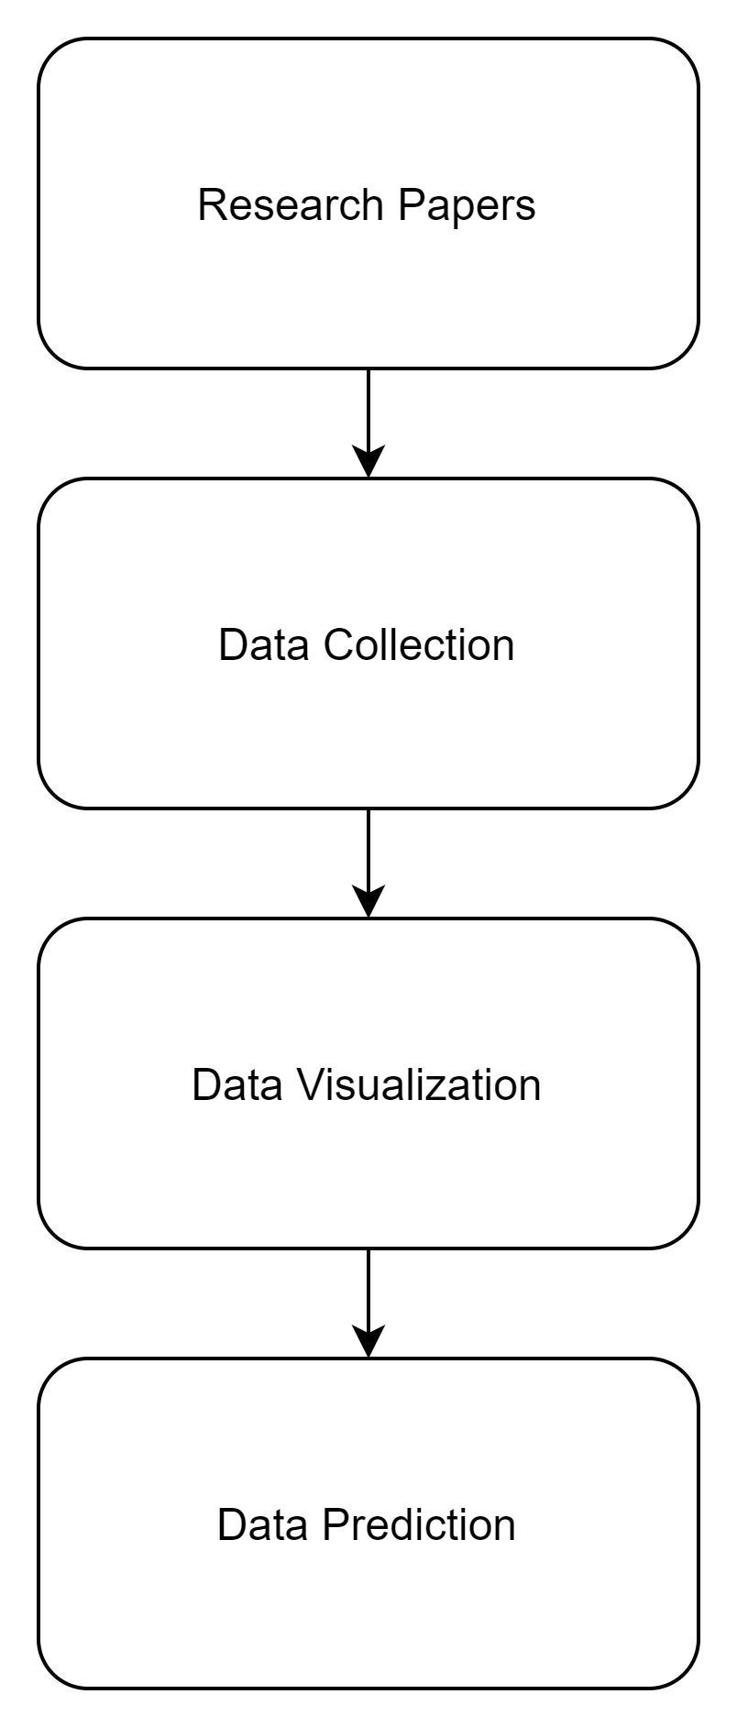

Slide 8
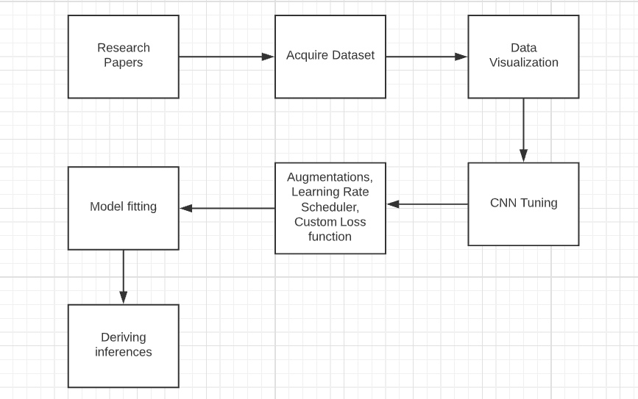

Slide 9
Research Paper
EMCNet: Automated COVID-19 diagnosis from X-ray images using convolutional neural network and ensemble of machine learning classifiers - Prottoy Saha *, Muhammad Sheikh Sadi, Md. Milon Islam Findings: four ML classifiers were combined to develop an ensemble of classifiers, which ensures better results for the dataset of various sizes and resolutions The models were trained and tested with a dataset of 1320 images where recent developing systems have conducted their research with comparatively small COVID-19 datasets. The model showed excellent performance with 98.91% accuracy, 100% precision, 97.82% recall, and 98.89% F1-score.

Slide 10
Research Paper
Automatic COVID-19 Detection from X-Ray images using Ensemble Learning with Convolutional Neural Network AMIT KUMAR DAS, SAYANTANI GHOSH, SAMIRUDDIN THUNDER , ROHIT DUTTA , SACHIN AGARWAL and AMLAN CHAKRABARTI Findings: three state-of-the-art deep learning models, DenseNet201, Resnet50V2 and, Inceptionv3 have been adopted and ensembled. The proposed model has achieved a classification accuracy of 95.7%. Even more important fact is it has given a sensitivity of 98%.

Slide 11
Research Paper
COVID-19 Prediction and Detection Using Deep Learning - Moutaz Alazab, Albara Awajan, Abdelwadood Mesleh, Ajith Abraham, Vansh Jatana, Salah Alhyari Findings: A diagnosis model using VGG16 was proposed to detect COVID-19 using chest X-ray images. The model allows the rapid and reliable detection of COVID-19, enabling it to achieve an F-measure of 99% using an augmented dataset. In a future study, we will consider diagnosing COVID-19 in chest CT scan images using the VGG-XX versions and compare their performances using larger datasets.

Slide 12
Datasets
There are three datasets used in this research work, one for the Data Visualisation part with the help of Tableau (by Salesforce) and the other two are for the CNN trained model for which Python is used -
Our World in Data - https://ourworldindata.org/coronavirus-source-data
Kaggle - https://www.kaggle.com/tawsifurrahman/covid19-radiography-database
Kaggle - https://www.kaggle.com/paultimothymooney/chest-xray-pneumonia

Slide 13
Dataset - For Data Visualisation
The dataset being used for Data Visualisation and Analysis is OWID (Our World In Data) which is a scientific online publication that focuses on large global problems such as poverty, disease, hunger, etc. This dataset contains tuples of about 80,000+ which gets updated on a daily basis, and the set is time-series data for the countries in the world (193), provided with their population and population density as well. The important attributes of this dataset that have come to our use are the daily report on the covid19 cases, deaths, tests done, and vaccinations.

Slide 14
Dataset - For Predictions
The dataset being used for training purposes it the COVID-19 Radiology Dataset and Pneumonia Detection Dataset from Kaggle. The dataset comprises of 3 classes of chest X-rays namely: Normal, Viral Pneumonia and COVID-19. The total number of X-rays available for COVID is: 3616 , Viral Pneumonia : 1346 and 10,192 Normal X-rays. developed the database of COVID-19 x-ray images from the Italian Society of Medical and Interventional Radiology (SIRM) COVID-19 DATABASE , Novel Coronavirus 2019 Dataset developed by Joseph Paul Cohen and Paul Morrison, and Lan Dao in GitHub [3] and images extracted from 43 different publications. Some sample data is shown in the next three slides -

Slide 15
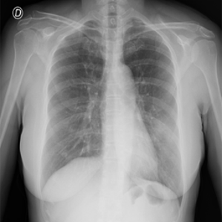
COVID - 19 Lung X-Ray

Slide 16
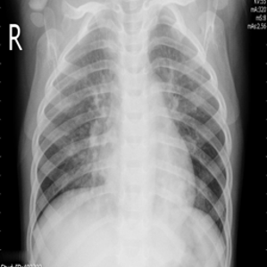
Viral Pneumonia Lung X-Ray

Slide 17
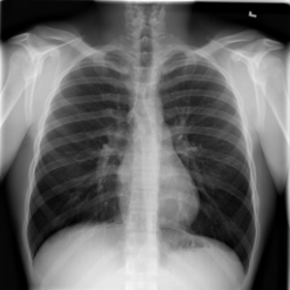
Normal Lung X-Ray

Slide 18
Data Visualization
Data Visualization is a graphical representation of data using charts, graphs, tables, and maps, etc. This technique is imperative as it allows us to see the trends and patterns in the data more clearly and effectively, which results in a better understanding of the data. These data visualization tools and techniques come to use even more when dealing with Big Data to analyze it and make data-driven decisions. In this study of Covid19, the software used for Data Visualization in Tableau. As far as Covid19 is concerned, it is very important to know the status of the spread factor across the world before moving ahead towards getting a conclusion with the help of the CNN Model.

Slide 19
Spatial Analysis
Spatial analysis includes any of the formal techniques which studies entities using their topological, geometric, or geographic properties. Here we have done it on three parameters -
Total Confirmed Cases
Total Deaths
Total Vaccinations

Slide 20
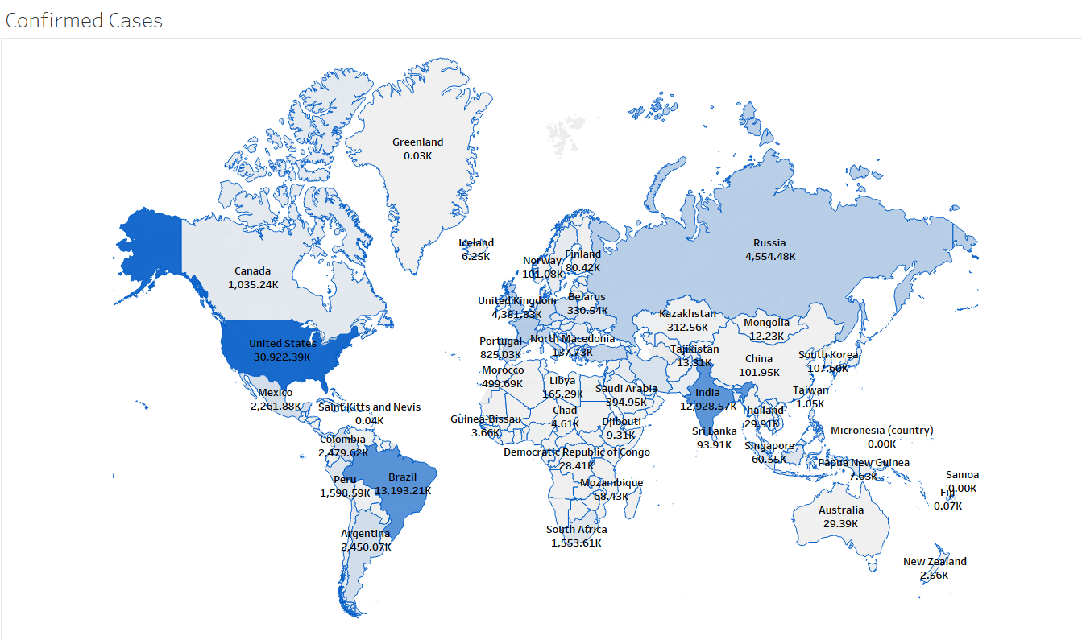

Slide 21
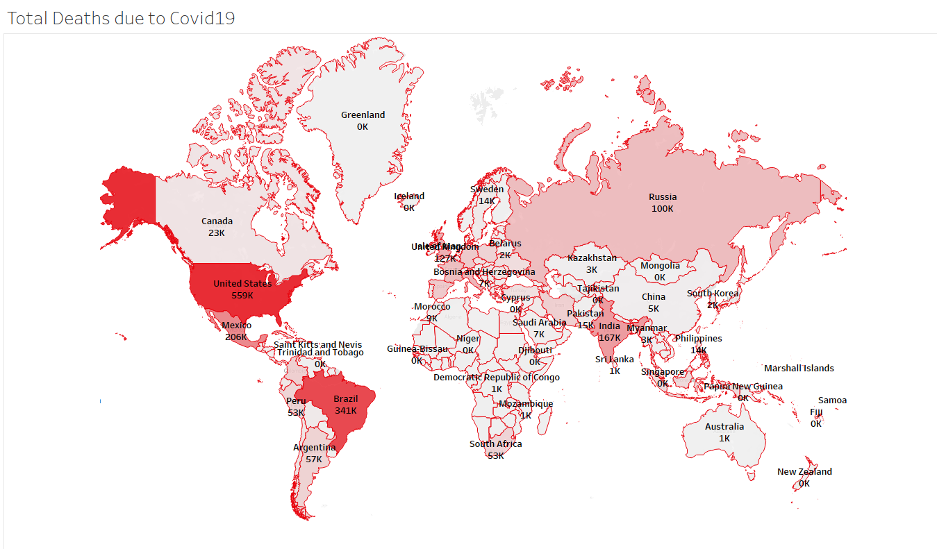

Slide 22
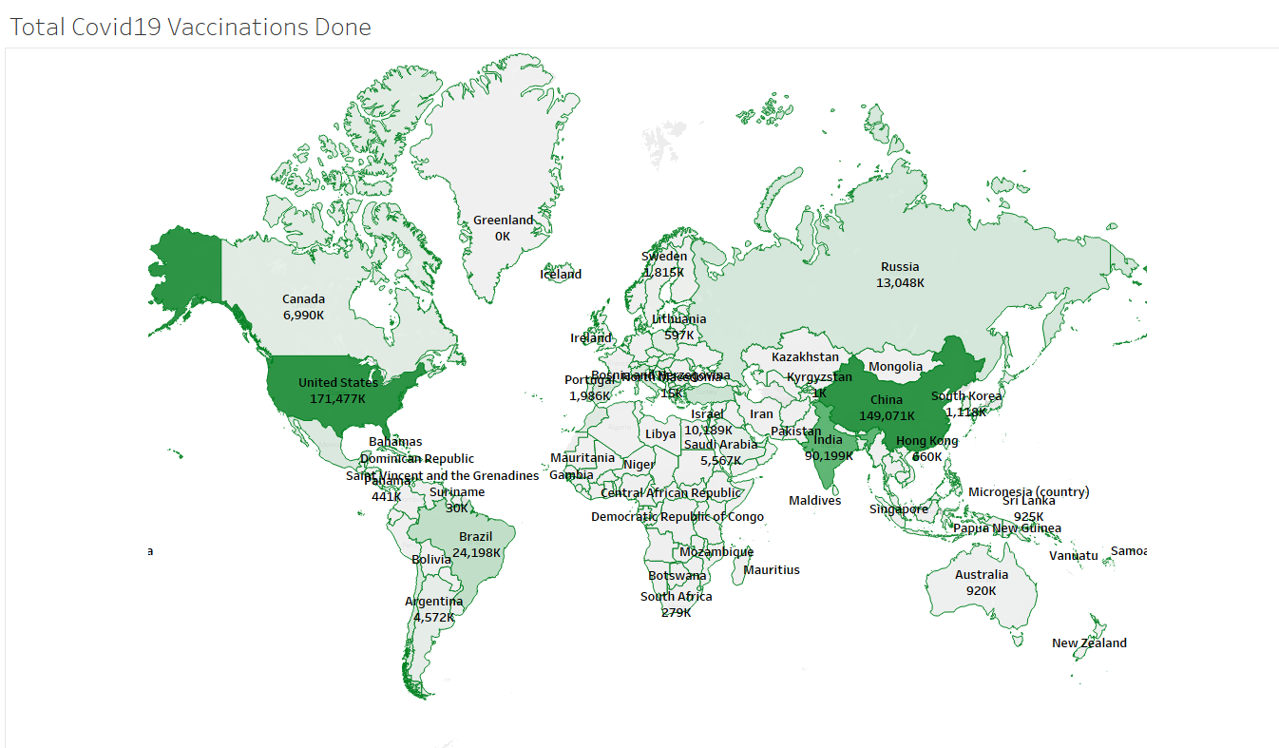

Slide 23
Time-Series Analysis (Continent-Wise)
Time series analysis is a statistical technique that deals with time series data, or trend analysis. Time series data means that data is in a series of particular time periods or intervals. Here we have used this technique for 3 trends we could look for -
New Covid19 Cases
Comparison b/w New Cases and Deaths
Comparison b/w New Vaccinations and New Vaccinations per million

Slide 24
New Covid19 Cases
The graph shown in the next slide helps us visually analyze the Active Covid19 Cases trends for all the continents. From which we can clearly see that at the end of 2020 the cases were highest in Europe and North America. In Asia, there is a different kind of pattern to be seen in which in January - February 2021 the cases were dropping by a lot, but after March started, The cases in Asia has peaked never like before and it is still increasing as we speak. This increase in Asia currently indicates a second wave of Covid19 for which there could be many reasons like the Mutant State of Covid19 Traces, Lack of precaution, etc.

Slide 25
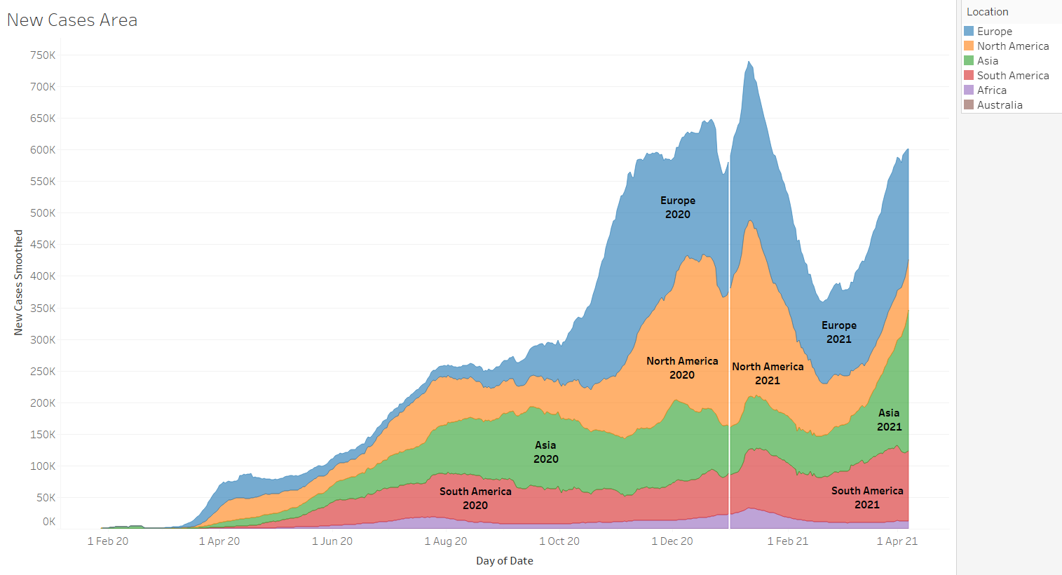

Slide 26
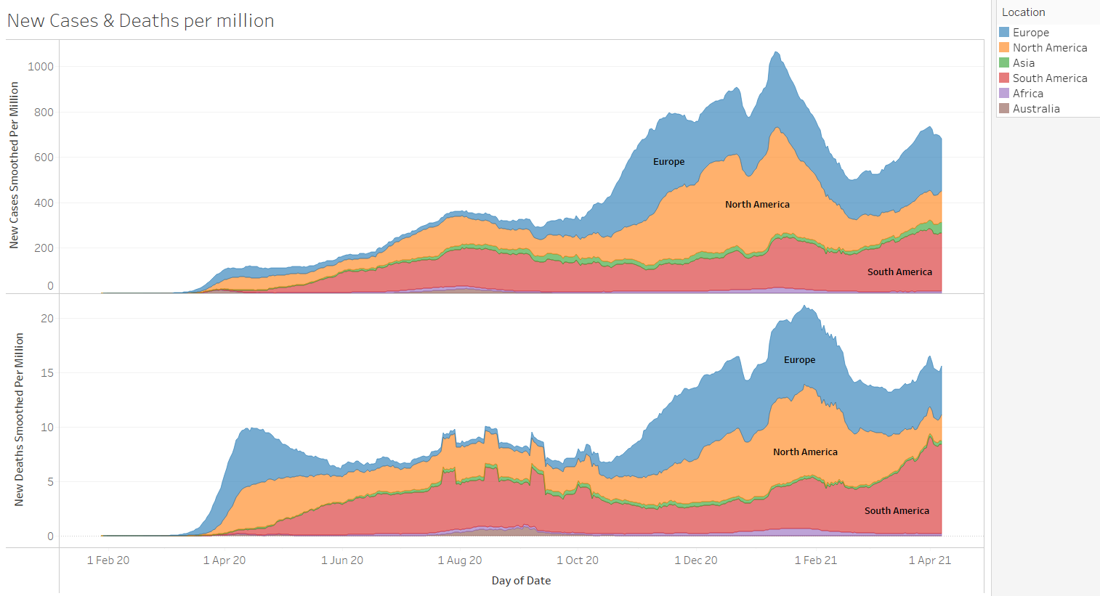

Slide 27
Comparison b/w New Vaccines & Vaccines per Million
The graph shown in the next slide helps us visually analyze the difference between New Vaccinations and New Vaccinations per million. From which you can observe like suppose for Asia, the increase in new vaccinations is drastic and has spiked even more since March 2021. But, if we take a look at New Vaccinations per Million then it comes 3rd to 4th among the six continents (Antarctica not included), this is due to the population in Asia is 456 crores, which is more than half of the world population. This means that the increase in vaccinations should increase even more to meet up with the population of the continent.

Slide 28
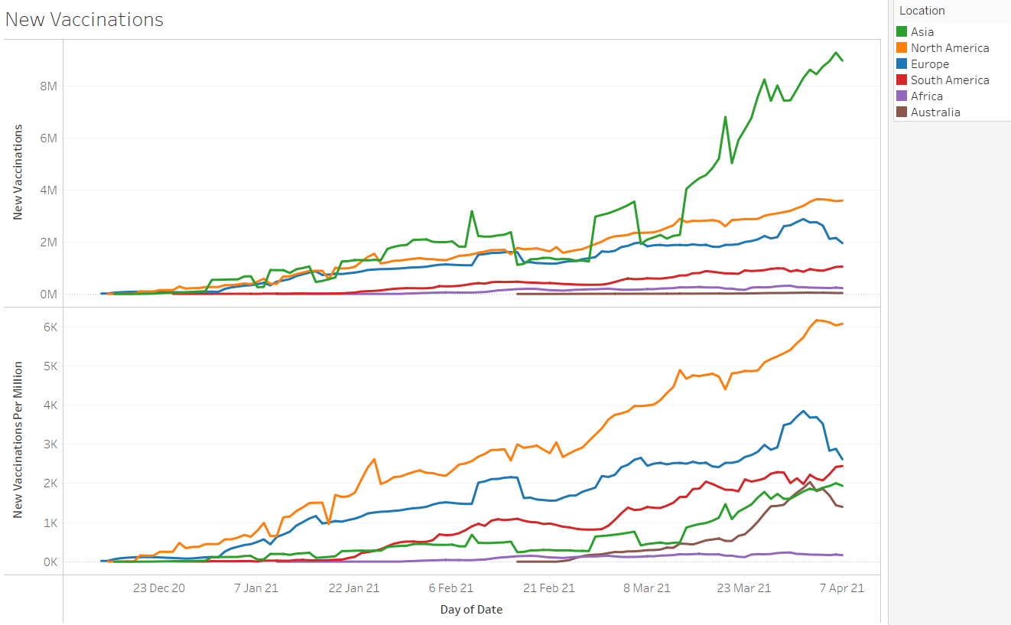

Slide 29
DATA AUGMENTATION
Total images used were 10484 and all images were resized to 224x224 pixels. To increase the accuracy of the X-rays, we performed data augmentation techniques like using zooming in to the image by 10%, providing a shear range of 0.1 or 10% and performing vertical flips. This would enable the model to perceive the image as humans do.
The next slide has an example of these tasks:

Slide 30
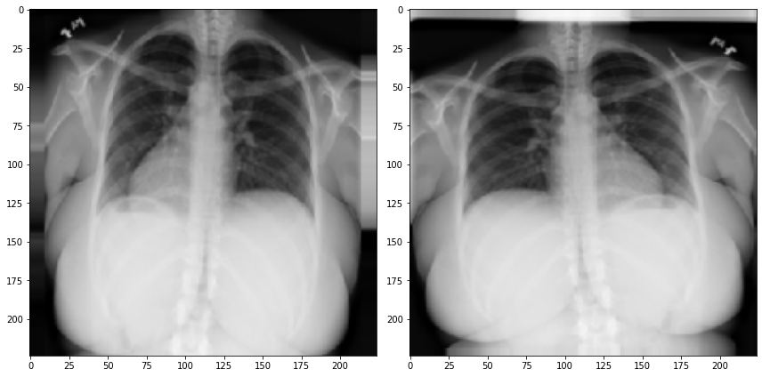

Slide 31
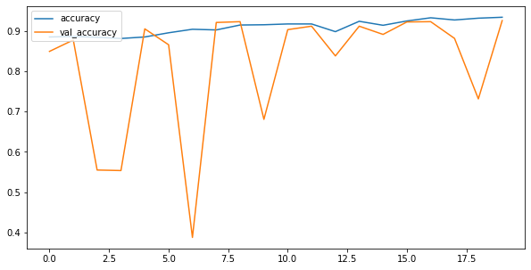
MODELING PIPELINE
First approach: To begin with, we designed our own CNN model consisting of a total of 21 layers. These layers comprised of Conv2D, MaxPool2D, BatchNormalization, Dropout, Dense and Flatten. The accuracy achieved in this case is shown in the graph:

Slide 32
Now while the final val_accuracy reaches 92.61% after 20 epochs, it showed some fluctuation in the val_accuracy. The accuracy was steadily increasing however the val_accuracy was not stable. This meant that the model was performing well in some cases but very poorly in others. Hence we decided to use other models. We employed several pre-trained models.

Slide 33
Pretrained Models Applied:
Pretrained models are models which have already been built for carrying out several tasks and do not have to be constructed from scratch. These models are very extensively built and can work very well on most of the datasets.
We used the following pretrained models: 1. EfficientNetB3 2. VGG16 3. ResNet152 4. MobileNetV2

Slide 34
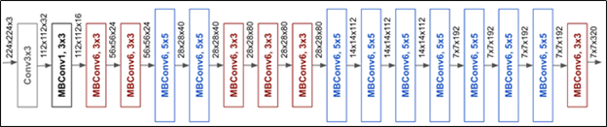
EfficientNetB3
EfficientNet is a convolutional neural network architecture and scaling method that uniformly scales all dimensions of depth/width/resolution using a compound coefficient. Unlike conventional practice that arbitrarily scales these factors, the EfficientNet scaling method uniformly scales network width, depth, and resolution with a set of fixed scaling coefficients. Given below are the layers in EfficientNet.
With our pipeline using imagenet, a batch size of 32, learning rate of 1e-4 and 10 epochs, the highest validation accuracy attained is 98.6%

Slide 35
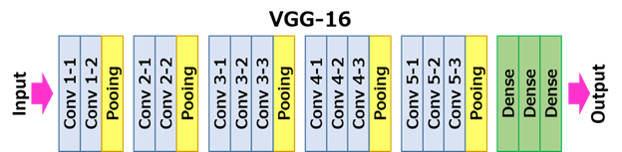
2. VGG16
It is one of the best pretrained models and can achieve excellent accuracy. The model achieves 92.7% top-5 test accuracy in ImageNet, which is a dataset of over 14 million images belonging to 1000 classes. While working very well with some other datasets, the model didn’t perform very well with signs of overfitting. It gave an accuracy of 91.13%. Hence this model too was not selected as the final model. The layers are given below:

Slide 36
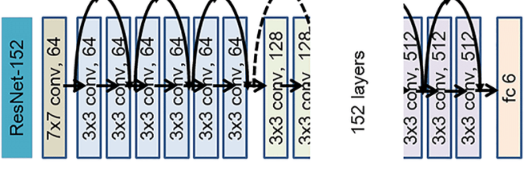
3. ResNet152
ResNet can have a very deep network of up to 152 layers by learning the residual representation functions instead of learning the signal representation directly. Given below is the architecture for ResNet152. Validation accuracy achieved with this was 93.14%. Given below are the layers in this model:

Slide 37
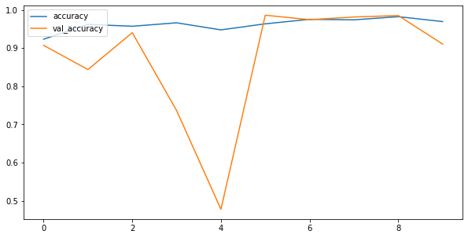
Analysis
Since the results from EfficientNetB3 model in the form of accuracy was the best, it was selected as the best model.The figure shows the epochs that the model ran. There were a total of 10 epochs that were run on this model and provided an accuracy of 98.6%.

Slide 38
Final Accuracies
The table below gives a description of the final accuracies achieved from the models:
MODEL | VALIDATION ACCURACY
EfficientNetB3 | 98.60%
ResNet152 | 93.18%
Custom CNN | 92.61%
VGG16 | 91.13%
MobileNetV2 | 88.56%

Slide 39
CONCLUSION
COVID-19 pandemic has posed a lot of challenges for people all over the world. With not much information available, it gets increasingly difficult to deal with the disease. However with such technological advances, we are able to correctly extract the features of this disease. Using X-Rays is one efficient way to understand more about the disease. Deep Learning has already made tremendous success in this field and has efficient use with this dataset. EfficientNetB3 algorithm proved to be the most helpful in identifying the minute differences between the three classes.

